Slide 1
Logistic Regression

Slide 2
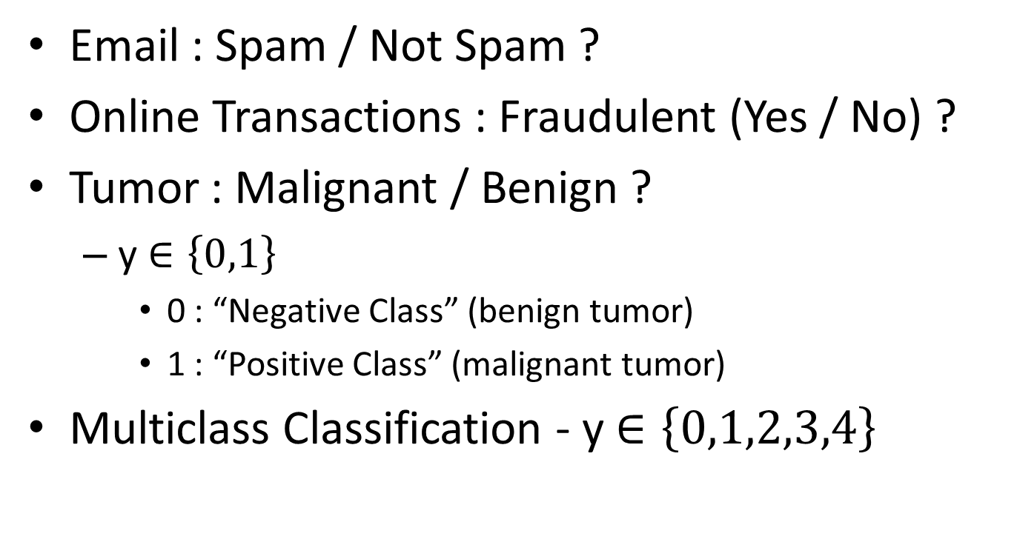
Classification
Email : Spam / Not Spam ?
Online Transactions : Fraudulent (Yes / No) ?
Tumor : Malignant / Benign ?
y $∈\left\{0,1\right\}$
0 : “Negative Class” (benign tumor)
1 : “Positive Class” (malignant tumor)
Multiclass Classification - y $∈\left\{0,1,2,3,4\right\}$

Slide 3
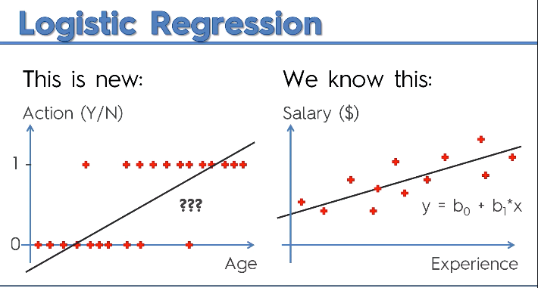

Slide 4
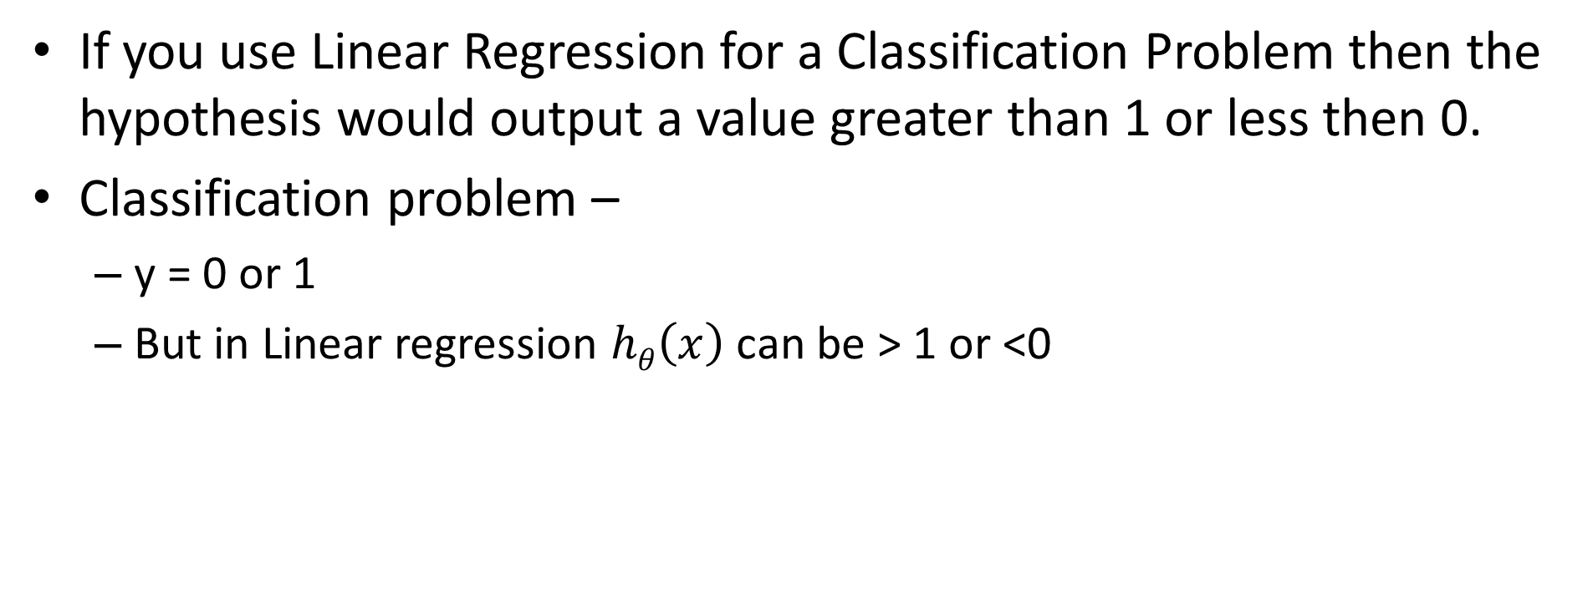
Can Linear Regression be used for Classification?
If you use Linear Regression for a Classification Problem then the hypothesis would output a value greater than 1 or less then 0.
Classification problem –
y = 0 or 1
But in Linear regression $hθ\left(x\right)$ can be > 1 or <0

Slide 5
To attempt classification, one method is to use linear regression and map all predictions greater than 0.5 as a 1 and all less than 0.5 as a 0. However, this method doesn't work well because classification is not actually a linear function.
The classification problem is just like the regression problem, except that the values we now want to predict take on only a small number of discrete values. For now, we will focus on the binary classification problem in which y can take on only two values, 0 and 1.

Slide 6
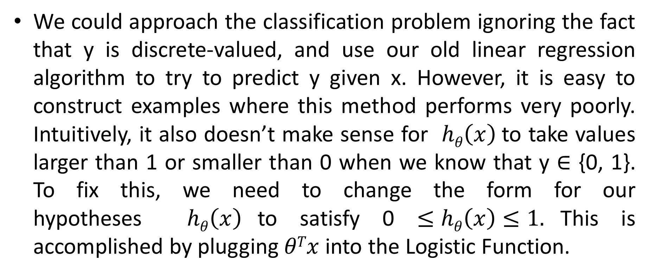
We could approach the classification problem ignoring the fact that y is discrete-valued, and use our old linear regression algorithm to try to predict y given x. However, it is easy to construct examples where this method performs very poorly. Intuitively, it also doesn’t make sense for $hθ\left(x\right)$to take values larger than 1 or smaller than 0 when we know that y ∈ {0, 1}. To fix this, we need to change the form for our hypotheses $hθ\left(x\right)$to satisfy 0 $≤hθ\left(x\right)≤1.$This is accomplished by plugging $θTx$ into the Logistic Function.

Slide 7
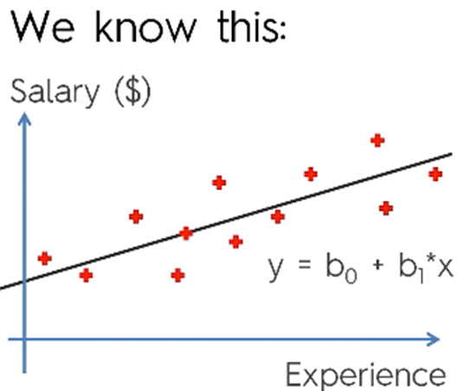
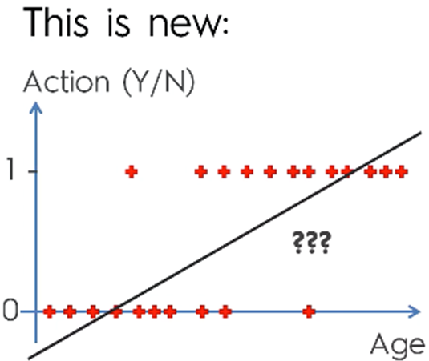

Hypothesis Function
For classification we need a Hypothesis representation which will output value between 0 and 1. 0 $≤hθ\left(x\right)≤1$
y = b₀ + b₁ * X
p = 1
1 + e^{-y}
ln p = b₀ + b₁ * X
1 - p

Slide 8
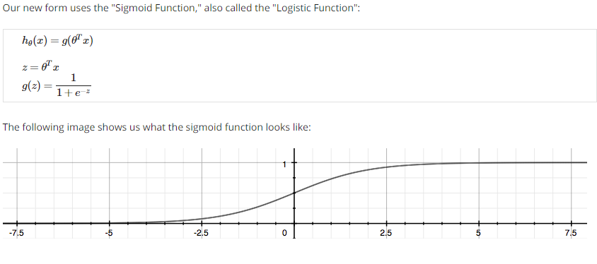
Sigmoid or Logistic Function

Slide 9
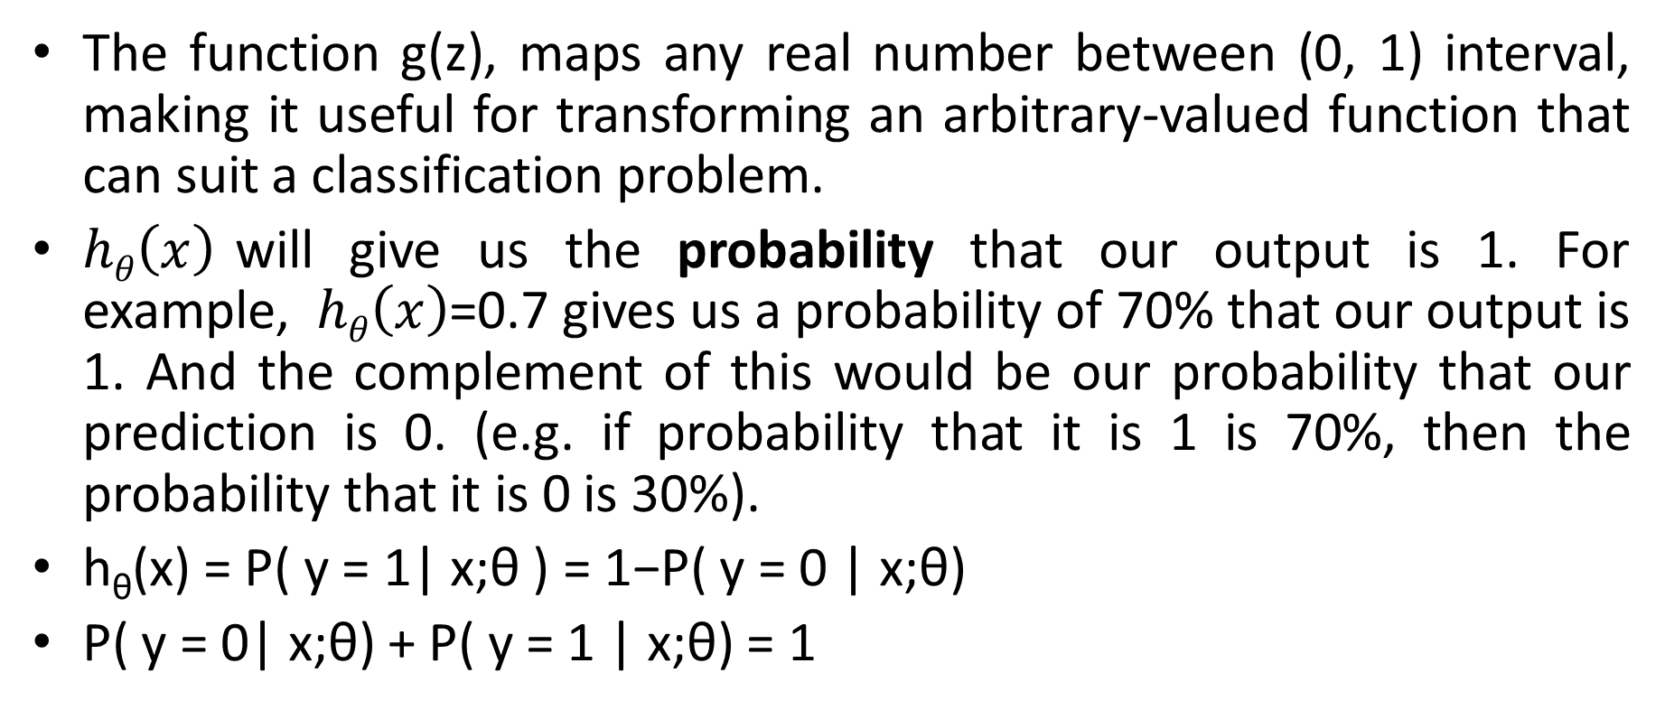
The function g(z), maps any real number between (0, 1) interval, making it useful for transforming an arbitrary-valued function that can suit a classification problem.
$hθ\left(x\right)$will give us the probability that our output is 1. For example, $hθ\left(x\right)$=0.7 gives us a probability of 70% that our output is 1. And the complement of this would be our probability that our prediction is 0. (e.g. if probability that it is 1 is 70%, then the probability that it is 0 is 30%).
h_{θ}(x) = P( y = 1| x;θ ) = 1−P( y = 0 | x;θ)
P( y = 0| x;θ) + P( y = 1 | x;θ) = 1

Slide 10
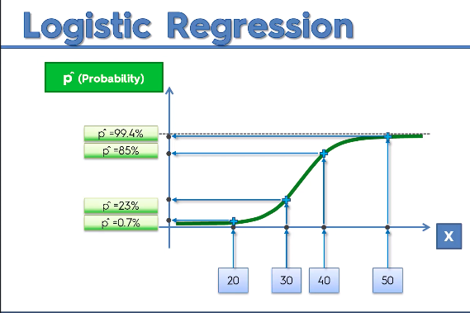

Slide 11
